Slide 1
Meaning of Political Science
Political Science systematically studies political Structure process and behaviors. It seeks to understand how government operate, how policies are formulate and impact of political decision on society. Political science is an interdisciplinary field the intersect with economics, history, sociology, law and among other area.
The term political science is derived from Greek word “Polis” meaning city state and “scire” meaning to know. Thus political Science Originally referred to study of city states but has since evolve to encompass the study of all form of government and political entities.
Essential elements of Politics.
Politics is an activities.
Politics is universal and changeable.
The origin of politics was from struggle and conflict.
Politics is beyond the boundaries or national territory.
Politics is to gain power and authority.
In polities, there are no stability.

Slide 2
Quotes by the export about Political Science
Political Science is the study of state. Aristotle
Political science is the study of who gets what, when and how. Harold Lasswell
Political science is the authoritative allocation of value for a society. David Easton
Political Science deals with the governance and organization of society through laws and social contract. Jean Jacques Rousseau
Political Science is the study of the distribution and exercise of power within a given social order.- Max Weber

Slide 3
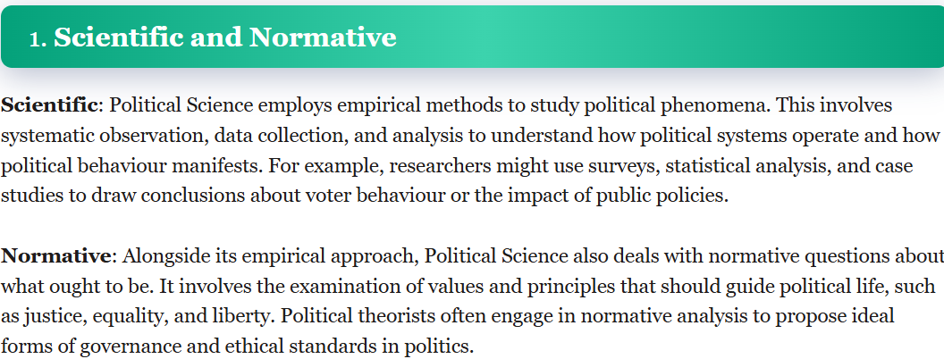
Nature of Political Science
The nature of Political Science is multifaceted and complex, reflecting the diverse ways. Here are the some key aspects that defines the nature of political Science.

Slide 4
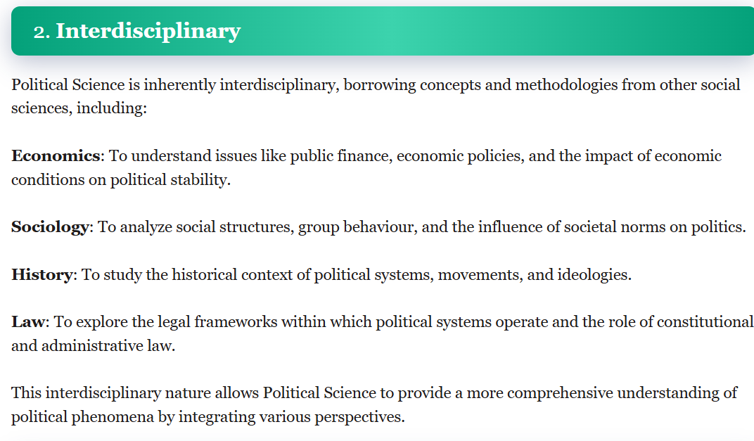

Slide 5
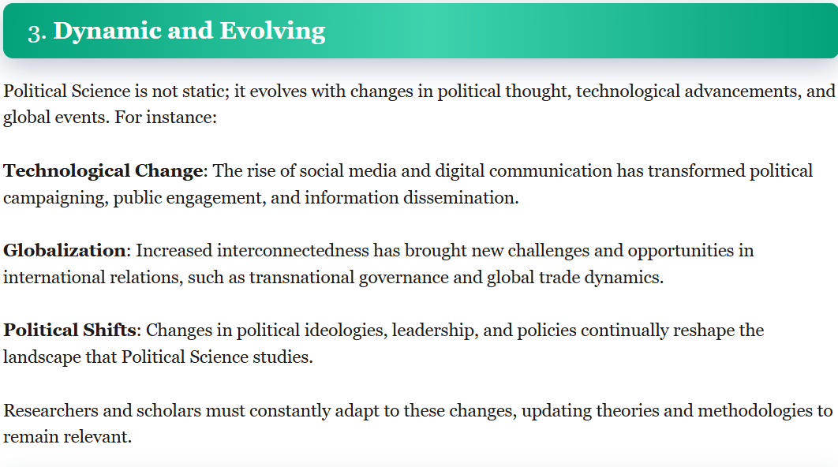

Slide 6
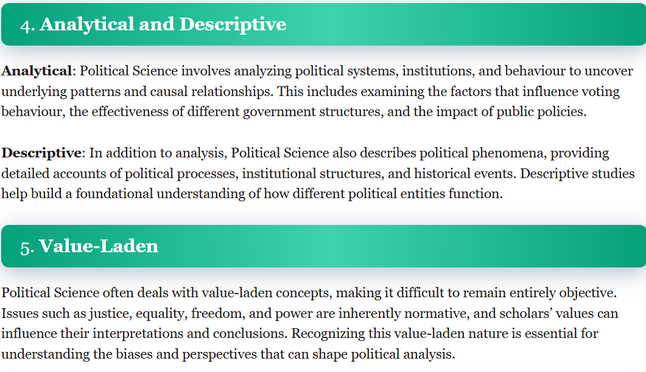

Slide 7
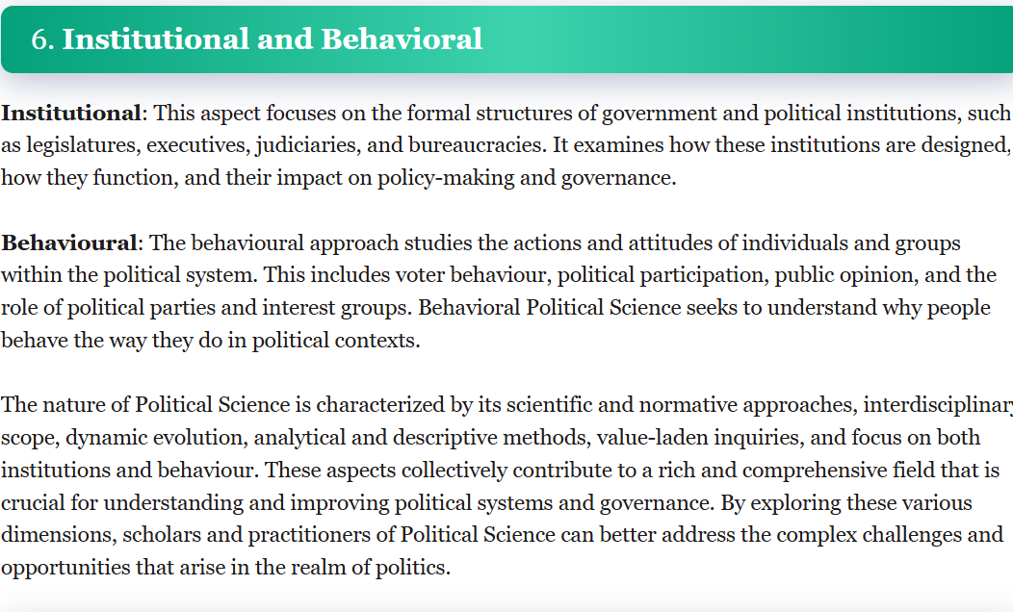

Slide 8
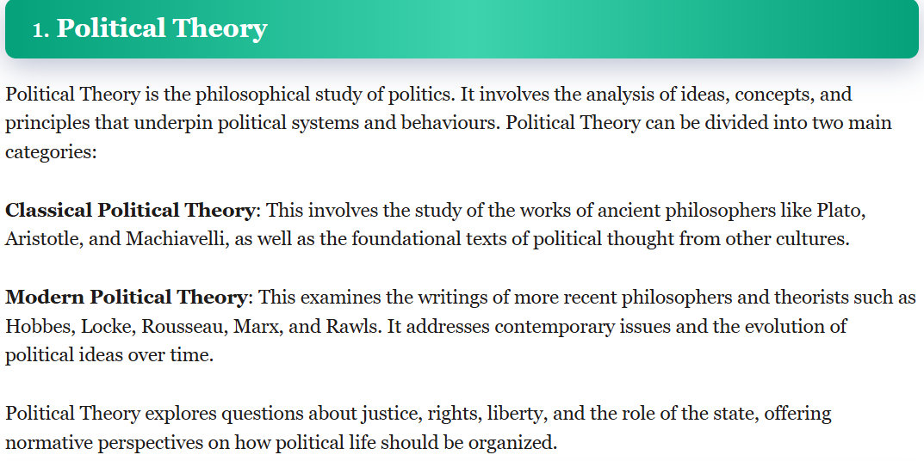
Scope of Political Science
The scope of political science is vast and multifaceted, encompassing various subfield and approach to understanding political Phenomena. It covers the study of political theory, institution, behaviors, policies and international relations. Here’s a detail explanation of the Primary area that defines scope of political science.

Slide 9
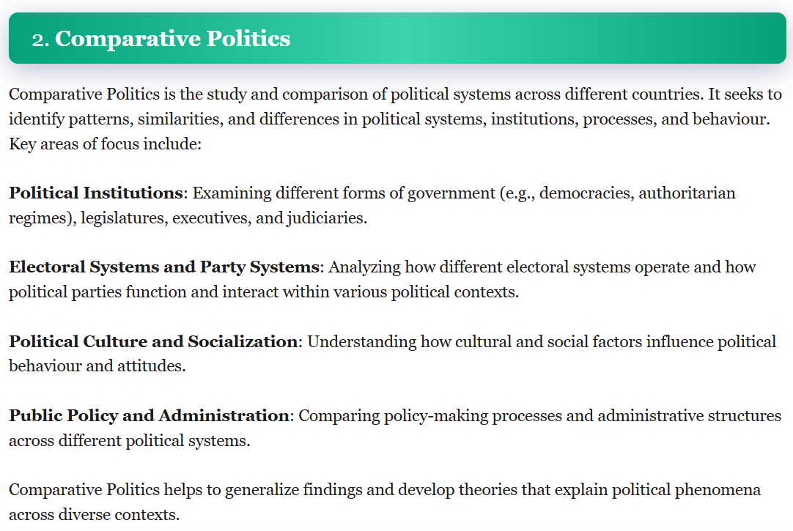

Slide 10
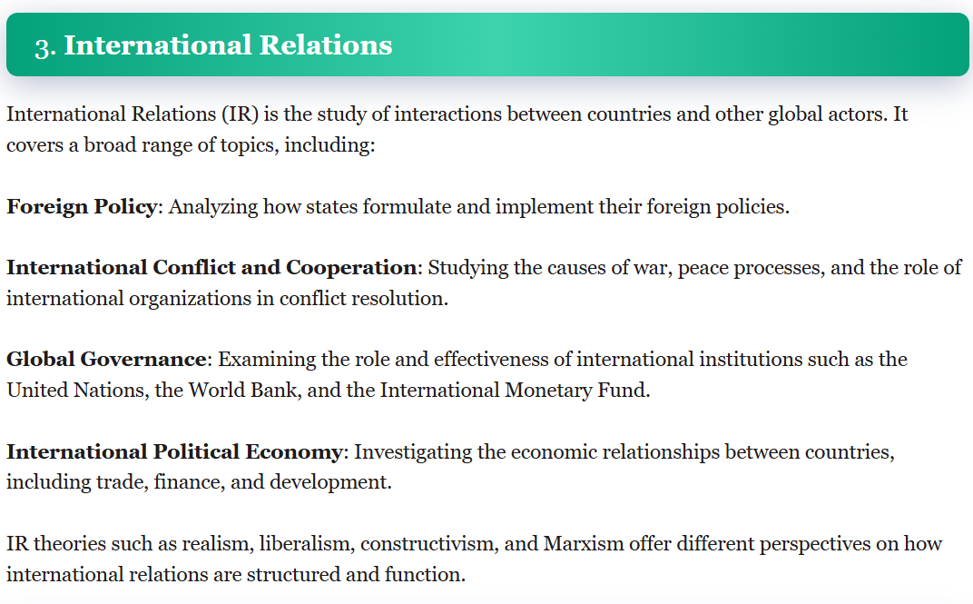

Slide 11


Slide 12
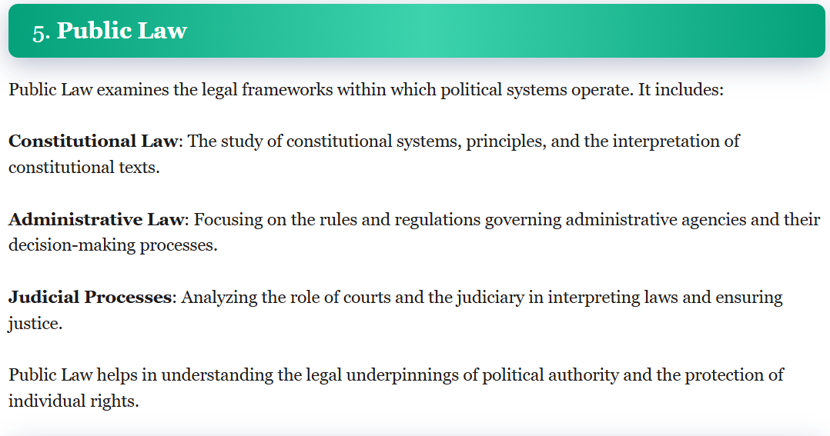

Slide 13
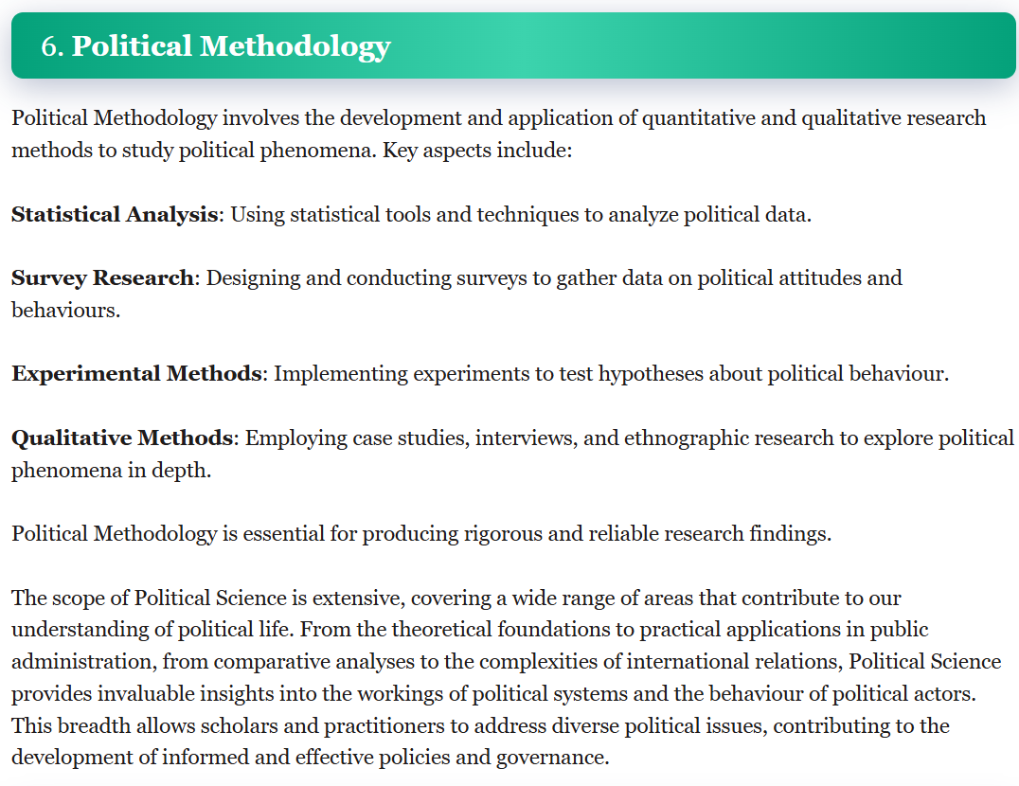

Slide 14
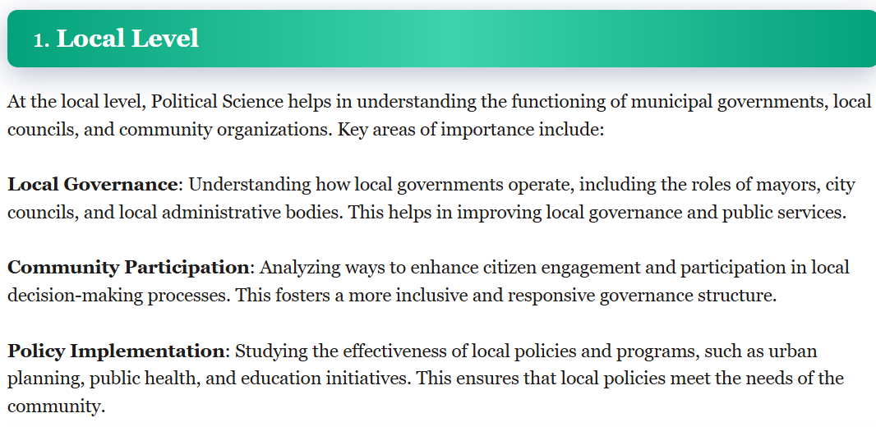
Importance of Political Science
Political Science plays a critical role in understanding and shaping political process, institutions and behavior at all level of society-from local communities to global interactions . Its importance can be highlighted through aspects

Slide 15
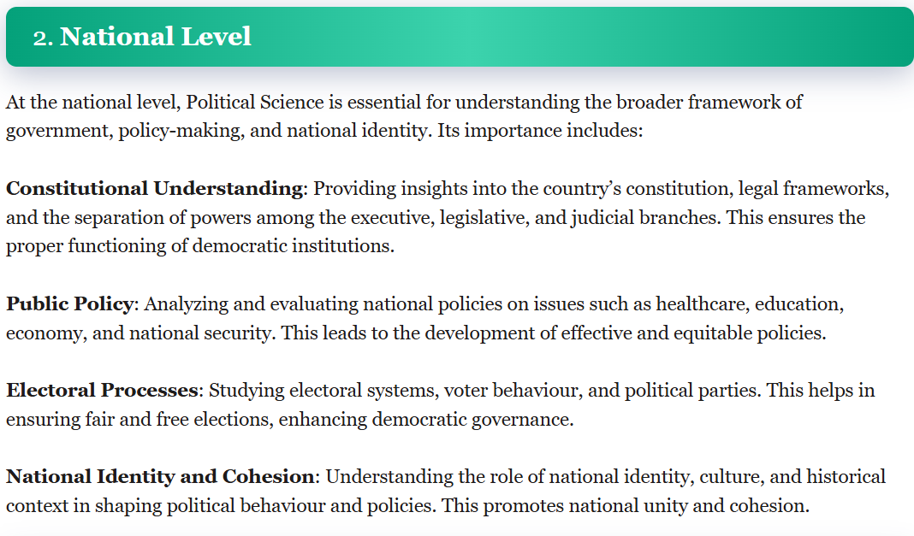

Slide 16
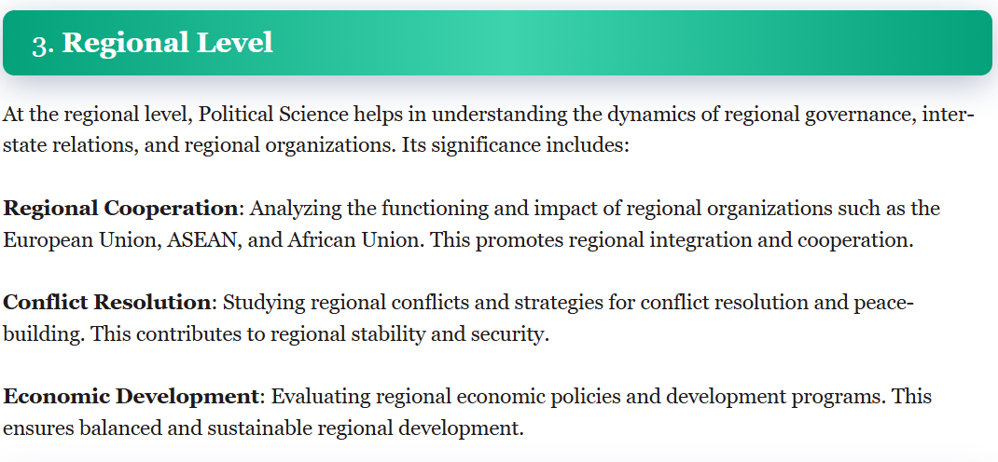

Slide 17
